Slide 1

REINVENTING FUN

Slide 2

WHY SO SERIOUS?

Slide 3

SCIENTISTS TELL US THAT AS HUMANS WE CRAVE ENJOYMENT AND FUN

Slide 4
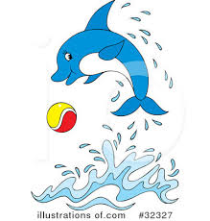
THE LARGER THE ANIMALS BRAIN THE MORE FUN IT ENGAGES IN( AS IN THE CASE OF DOLPHINS)

Slide 5

FUN SERVES A REAL PURPOSE…IT HELPS US GROW IN OUR EMOTIONAL BRAIN CENTRE…OUR AMYGDALA….
SO WE DEVELOP BETTER INTERPERSONAL SKILLS

Slide 6
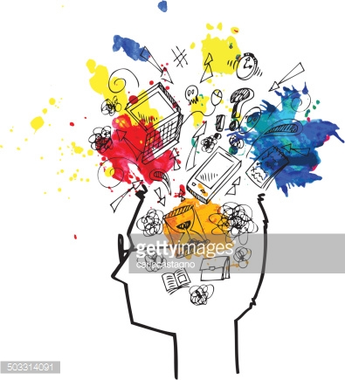
SCIENTISTS ALSO THINK PLAY HAS A ROLE IN LEARNING AND IT PROMOTES PRE FRONTAL CORTEX DEVELOPMENT
( FRONT PART OF YOUR BRAIN, OVER YOUR EYEBROWS)……

Slide 7

PLAY HELPS IN EXECUTIVE FUNCTIONS, INCLUDING DECISION MAKING.

Slide 8
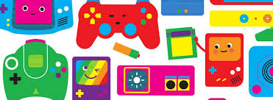
GAMIFICATION
CAN LIFE BE A GAME?

Slide 9

FUN GAMES ARE POWERFUL….THEY CAN CHANGE BEHAVIORS

Slide 10
Alternative Video -Piano stairs.mp4

Slide 11
The Speed Camera Lottery - The Fun Theory.mp4

Slide 12

OTHER EXAMPLES…..

Slide 13


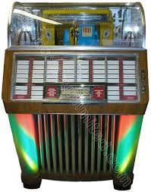
A JUKEBOX THAT ONLY PLAYS MUSIC WHEN YOU RECYCLE CANS AND BOTTLES

Slide 14



SOUND EFFECTS THAT MAKE THROWING AWAY TRASH A CARTOON LIKE EXPERIENCE!

Slide 15
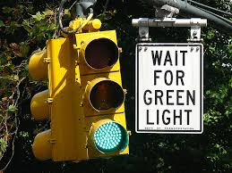
TRAFFIC LIGHT SYSTEM THAT DISPLAYS FUN FACTS AND TRIVIA WHEN THE LIGHT IS RED TO ENCOURAGE PEOPLE TO ABIDE BY THE TRAFFIC RULES

Slide 16



FIVE TAKEAWAYS
THE THINGS THAT REALLY STOOD OUT FOR YOU IN THIS COURSE

